Slide 1
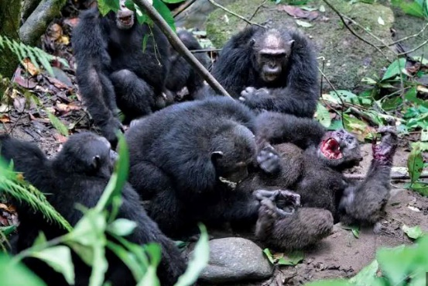
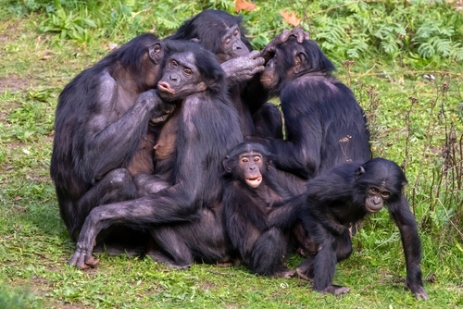
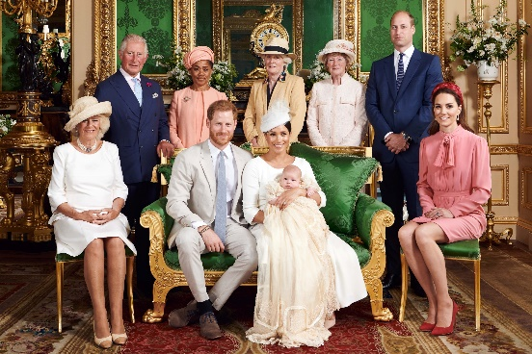
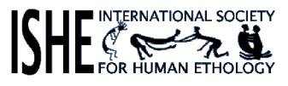
Human family as a historical artifact and as an ecological adaptation
Using phylogenetic comparative methods to study evolution of human behavior
Pavel Duda
Gabriel Šaffa

Slide 2
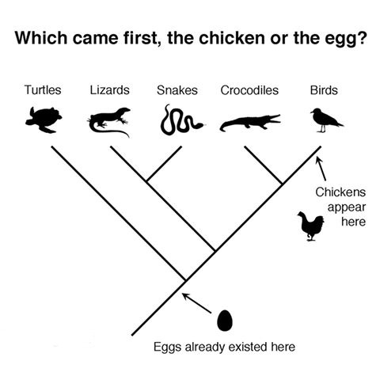
Nothing in Biology Makes Sense Except in the Light of Evolution
and
Nothing in evolution makes sense except in the light of phylogeny

Slide 3
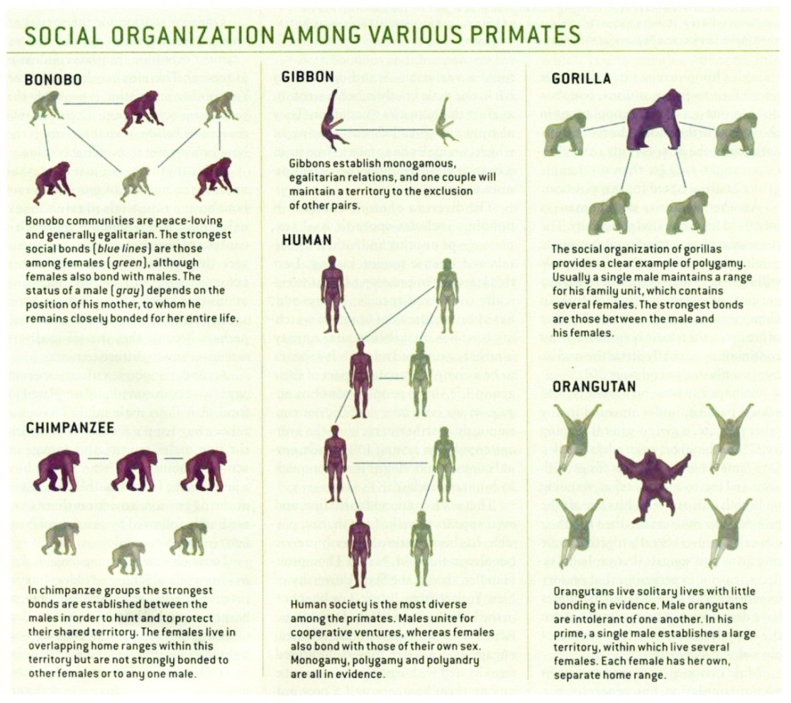
Great ape behavioral diversity
nuclear families
fusion-fission
(female dominance)
harems
fusion-fission
(male dominance)
dispersed
harems
multilevel social organization

Slide 4
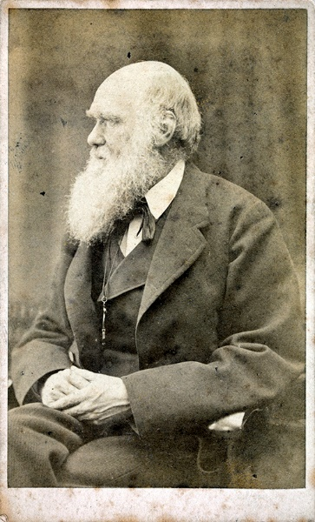
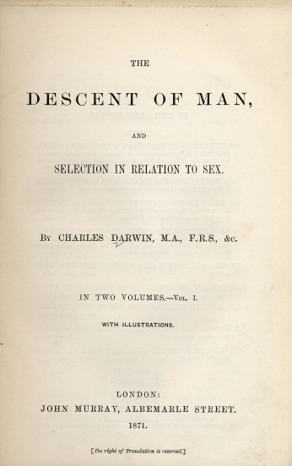
Evolutionary origins of human behavior
“It is ... probable that Africa was formerly inhabited by extinct apes closely allied to the gorilla and chimpanzee and as these two species are now man’s nearest allies it is somewhat more probable that our early progenitors lived on the African continent than elsewhere.”
"We must not fall into the error of supposing that the early progenitor of the whole Simian stock including man was identical with, or even closely resembled, any existing ape or monkey." Charles Darwin, 1871

Slide 5
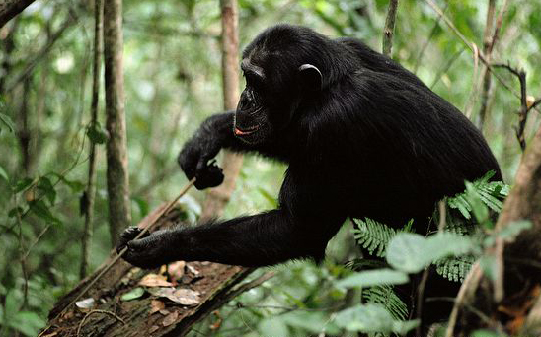
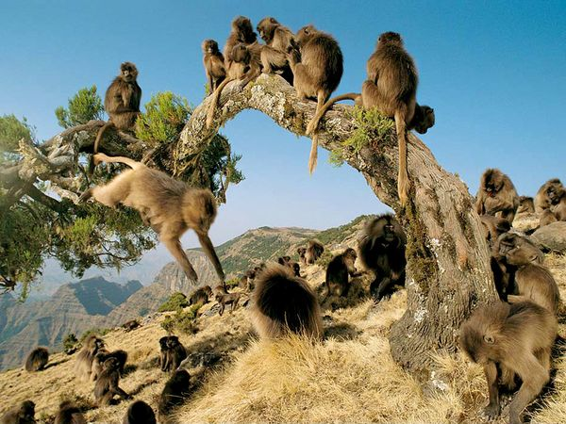
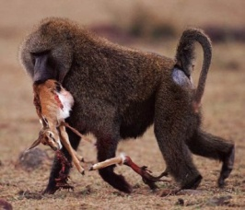
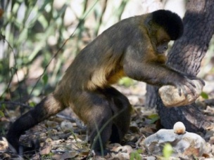
Using extant species to "model" our past
Extant species serve as models of early hominin behavior
Referential models (homology- or analogy-based) use a living species as a proxy for common ancestor(s)
Non-referential (‘conceptual’ or ‘strategic’) models use information from evolutionary biology and behavioral ecology to identify aspects of the probable behavior of common ancestor(s)
Notes:
But that is OK. I mean, what else shouls we use? Evobio is a science that infers past processes from presnt-day patterns. And than it uses a knowledgeof these processes to better understand those patterns…
Celé 20. století se neslo ve znamení hledání primáta, který by byl co nejlépe odpovídal předpokládaným předkům…
While the fist evolutionists remained intentionally vague concerning the characteristics of the ape-man ancestors (e.g., Huxley, 1863; Darwin, 1871: 520), successive researches vigorously used living apes as explicit models for the former (Tuttle et al., 1974; Latimer et al., 1981). This shift can be characterized by the quotation by the early prebrachiationist Adolph H. Schultz: “For reasons not yet worked out I incline to the view that gibbons have retained a greater number of primitive characters which may have been the property of the ‘missing link’ than any other of the living apes” (Schultz, 1927: 40). The modeling techniques employed so far have been explicitly or implicitly based on preferred referential species or attempted to answer the question which extant species is (behaviorally) most similar to the common ancestor in question. Similar approaches dominated the whole 20th century.
Referential modelling vs. non-referential modeling, “conceptual”, or “strategic” modeling.
Referential models use as a template the social system of a particular nonhuman primate species whose ecology and behavior exhibit features believed to be analogous with those of the stem hominid species. In the I960s, for example, the savannah baboon was commonly seen as a model for the behavior of early hominids because it occupies an ecological niche and has a geographic distribution similar to those of Plio/Pleis- tocene hominids.
Conceptual models are defined as combining the unique morphological features of hominids with information from evolutionary ecology, sociobiology, and behavioral ecology to identify aspects of the probable social system of the proposed common ancestor of the earliest hominids. The conceptual modeling is based on the implicit assumption that only limited number of possible behaviors or strategies does exist, given the morphology and physiology of the species and the environmental constraints, so one is able to "predict" ancestral behavior on the basis of some general evolutionary rules (funkční morfologie, r-K kontinuum, behaviorální ekologie, inkluzivní fittness, teorie sexuální selekce, optimalita chování, …)
Snaha o vytvoření sjednoceného modelu lidské evoluce, která bude funkřním ekvivalentem newtonovského modelu ve fyzice. Logika: Je možné předpovědět chování předka, pokud máme dostatek informací (o jeho morfologii, paleoekologii). Jenže lidská evoluce není opakovatelný pokus.
Modely se liší v tom, že jedny se na znalosti biologie recentních druhů zakládají explicitně, zatímco ty druhé implicitně. Žádný skutečný rozdíl mezi nimi není
Referenční modely založené na homologii + analogii – šimpanzi (savanový zvlášť), orangutani, giboni, paviáni, gelady, malpy, chápani
Referenční modely založené čistě na analogii – psi hyenovití, kytovci, sloni, racek stříbřitý, sup mrchožraví, lemčíci
Savannah chimpanzee – Referenční (prolnutí homo- a analogie)
Seedeater – Prolnutí konceptuálního a referenčního modelování
Pro referenční modelování je klíčová volba modelu, která se mění s přísunem nových informací či se změnou paradigmatu v primatologii (např. výroba nástrojů či samčí kooperativní lov vs. samičí volba partnera a přechod k monogamii). Přitom posun paradigmatu je často umožněn právě oním přísunem nových informací.

Slide 6
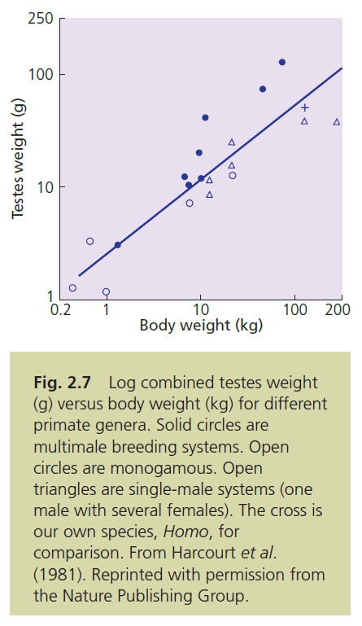
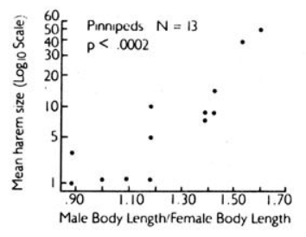
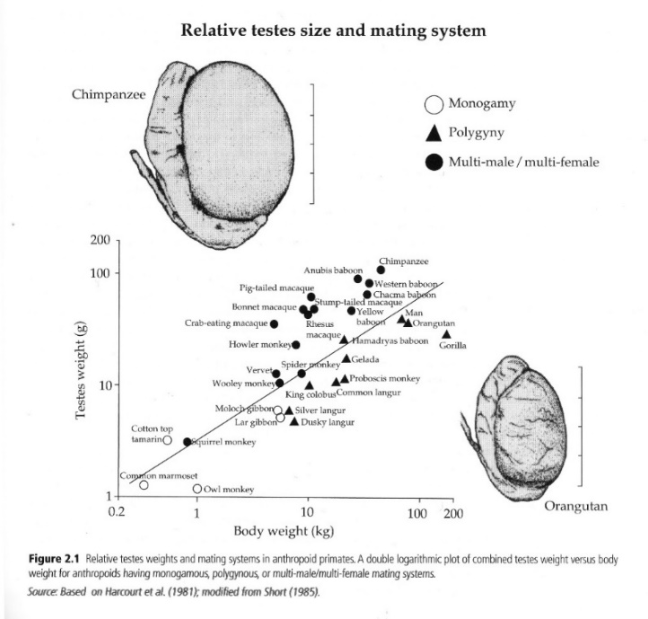
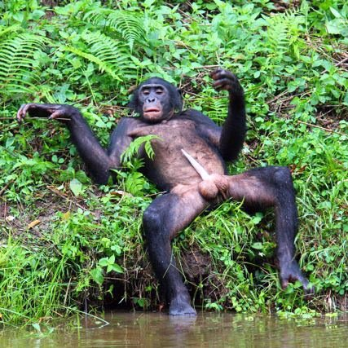
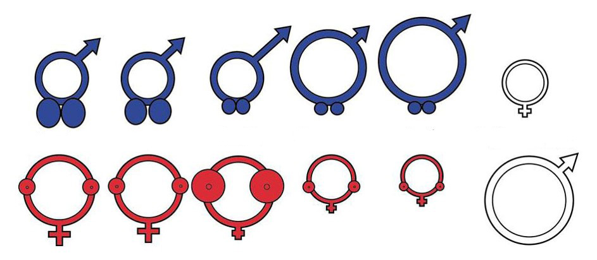
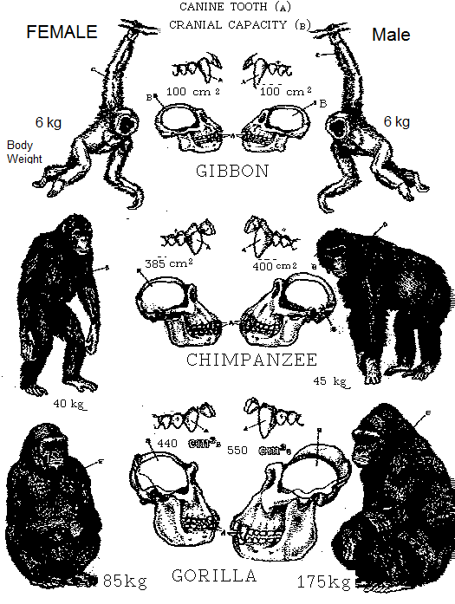
Non-referential modeling
Sexual dimorphism and testes size as a predictor of social mating system across mammals
General trade-off between sperm- and contest-competition
male (female
perspective)
female (male
perspective)
bonobo chimpanzee human orangutan gorila size proportion
Notes:
Fig. 2.7 Log combined testes weight (g) and log body weight (kg) for different primate genera. Solid circles = multimale breeding systems. Open cirles = monogamy. Open triangles = single-male systems. Cross = Homo sapiens for comparison.
Primates, bovids, pinnipeds…

Slide 7
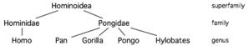
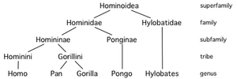
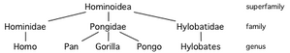
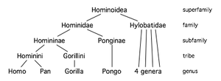
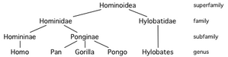
Changes of hominoid systematics
50s
80s
60s
70s
since the 90s
Notes:
Celé 20. století se neslo ve znamení taxonomického sbližování člověka a lidoopů…
Taxonomická nomenklatura je tu poněkud nepřehledná: Hominoidea = (Hylobatidae + Hominidae = (Ponginae + Homininae = (Gorillini + Hominini = (Panina + Hominina)))). Člověk tedy patří do subtribu Hominina, spolu s šimpanzi do tribu Hominini, spolu s s šimpanzi a gorilami do podčeledi Homininae, spolu s šimpanzi, gorilami a orangutany do čeledi Hominidae a spolu s šimpanzi, gorilami, orangutany a gibony do nadčeledi Hominoidea.
Příbuzenské vztahy mezi velkými lidoopi byly poměrně dlouho předmětem kontroverze.

Slide 8
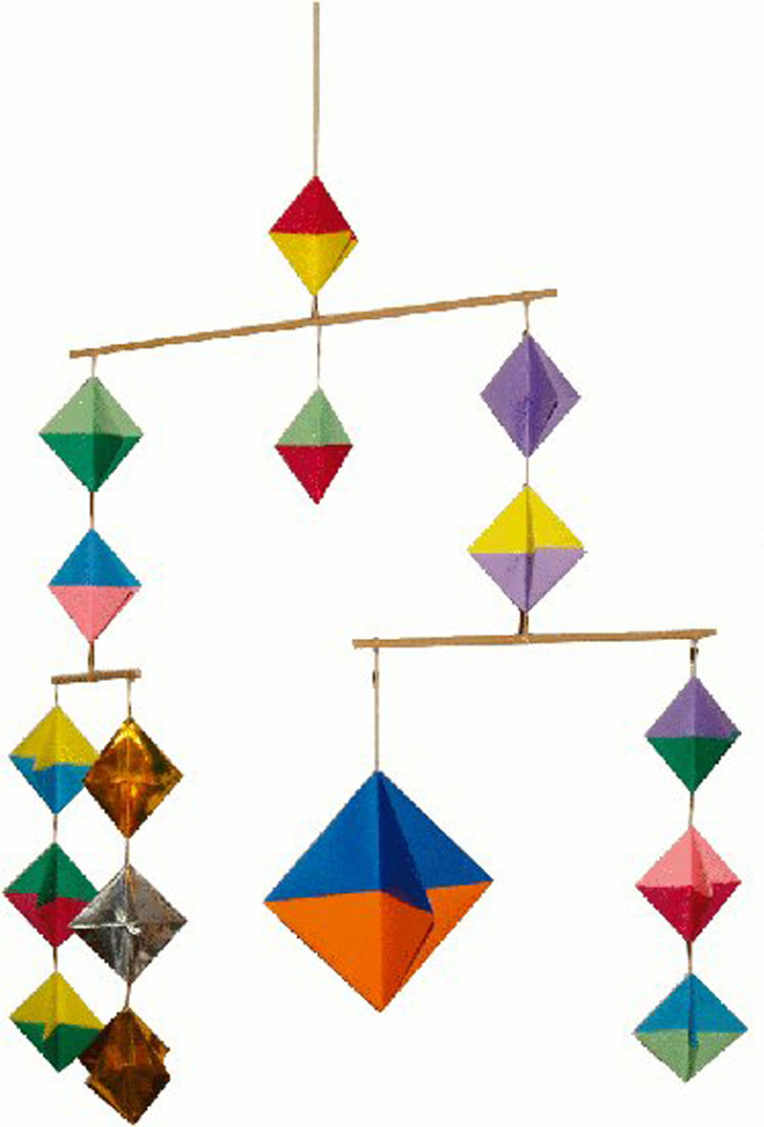
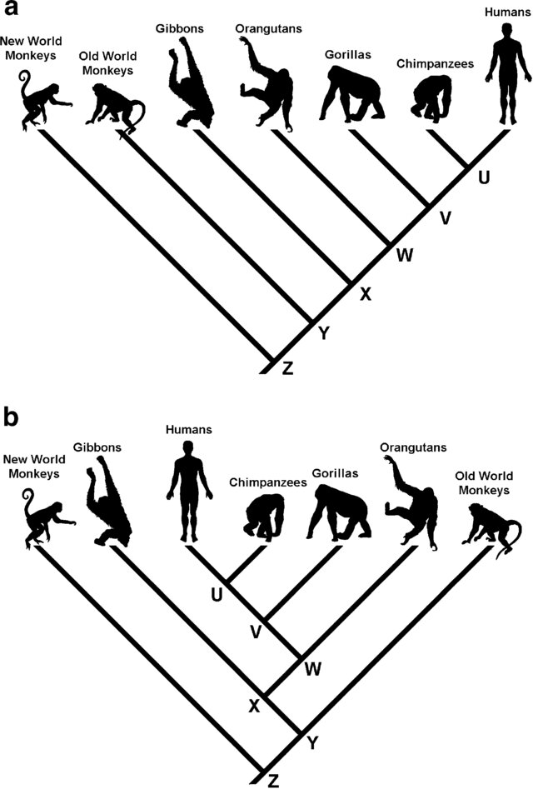
Cousins are not ancestors
But still…
Notes:
Fig. 14 Cousins are not ancestors, and humans are not descended from chimpanzees. a shows an evolutionary tree of anthropoid primates as it is often depicted, namely as an unbalanced, righ-tladderized tree with humans at the extreme end. Viewed in this way, several of the most common fallacies in interpreting trees can arise: for example, that humans are the endpoint of a " main line, " that there is a trend toward " human-ness " from left to right, that the human lineage includes a monkey ancestor, or that there has been no branching in the lineages leading to the other modern species of primates. All are absolutely false. This becomes clearer if a few internal nodes are rotated, as in b, which is an equally accurate depiction of primate relationships. Humans and chimpanzees are more closely related to each other than either is to gorillas, orangutans, or any other living primates. However, note that " chimpanzees, " although depicted as one terminal node here, includes both the common chimpanzee (Pan troglodytes) and the bonobo (Pan paniscus). Humans are not descended from chimpanzees any more than chimpanzees are descended from humans; rather, the two share a common ancestor (U) that lived some 5–7 million years ago and that was neither a human nor a chimpanzee. " Monkeys " are divided into Old World and New World lineages. Old World monkeys share a more recent ancestor with apes (Y) than either does with New World monkeys (Z), which means that apes (including humans) and Old World monkeys are equally related to New World monkeys. Monkeys are not ancestral to humans: The two lineages are related as distant cousins, not as grandparents and grandchildren.
Misconception #5: Sibling versus Ancestor Mistaken assumptions that the ancestor of two modern groups must have been very similar to, or perhaps even was, one of the modern groups extend well beyond the case of crocodiles and birds. Any claim that two species represent each other’s closest living relative should not be construed as implying that one of the modern groups itself is an ancestor of the other nor even that the common ancestor looked anything like either of the two groups. For example, the hypothesis that whales and hippopotamuses are sister groups (e.g., Boisserie et al. 2005) does not imply that the ancestor of whales was a hippo nor that it would even have been thought of as being similar to a hippo were it encountered when it was alive. Not surprisingly, the fossil record of whales, which is becoming increasingly extensive, shows that the early ancestors of whales (e.g., Pakicetus, Ambulocetus) bore no substantial resemblance to modern hippos at all (Thewissen and Bajpai 2001; Thewissen and
Williams 2002).
Nowhere is this misconception more pronounced than in discussions of human evolution…

Slide 9
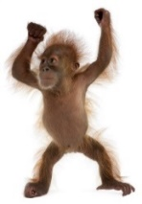



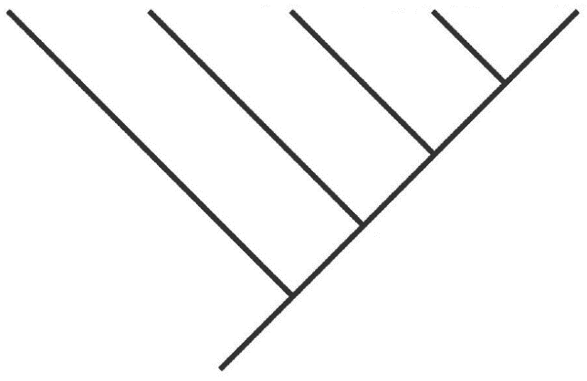
No main line and side tracks of evolution
Chororapithecus
Australopithecus
Lufengpithecus
Gigantopithecus
Ardipithecus
Sivapithecus
orangutan
orangutan
human
human
But still…
Notes:
Misconception #2: Main Line and Side Tracks Although it is clearly a critical first step, recognizing evolution as tree-like does not in itself eliminate progressionist interpretations of life’s history. Even those who acknowledge the branching nature of evolutionary change may continue to interpret it as a progressive process in which a “main line” has led to a distinct endpoint (namely Homo sapiens). In this narrative, all other modern species are derivatives of “side tracks,” anomalous offshoots of the main line to humans that all went astray for one reason or another. Even Huxley (1880) fell prey to this line of thinking when he suggested that the teleost fishes “appear to me to be off the main line of evolution—to represent, as it were, side tracks starting from certain points of that line.”
Figure 10a provides an illustration of how Huxley could reach such a false conclusion while still accepting the basic concept of tree-like branching. This represents an unbalanced, right-ladderized tree with representatives of several vertebrate lineages, including the cartilaginous fishes, teleost fishes, amphibians, birds, and the mammalian lineage as represented by humans. For many, an intuitive interpretation of this tree is that humans represent an endpoint of a “main line,” with all other lineages branching off from this line at some time in the past…
… Few readers would interpret Fig. 10b as implying that a main line exists with perch as the endpoint and humans and other mammals as a minor, early branching offshoot, even given the fact that teleost fishes make up roughly 50% of all vertebrate diversity, whereas mammals represent about 10%. Still, the logic behind such an obviously silly reading of this tree is no more fallacious than of the intuitive “main line” interpretation of Fig. 10a. To quote O’Hara (1992),

Slide 10
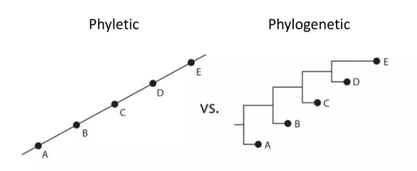
Which one of these four cladograms depicts different phylogenetic relationships than the other three?

Slide 11
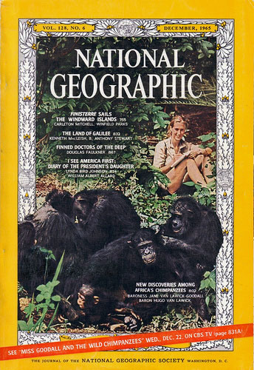
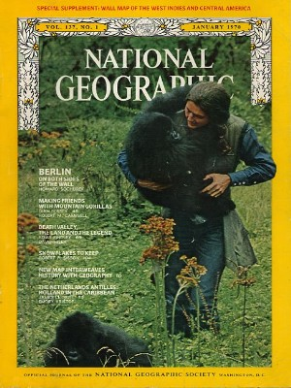
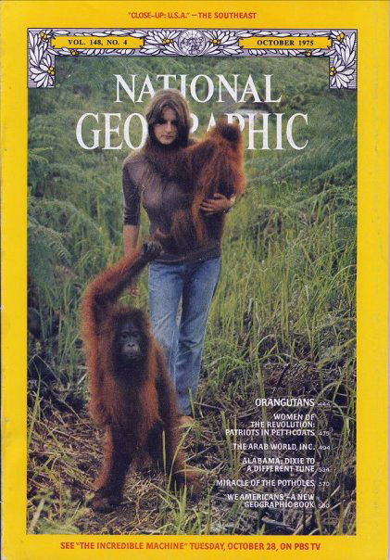
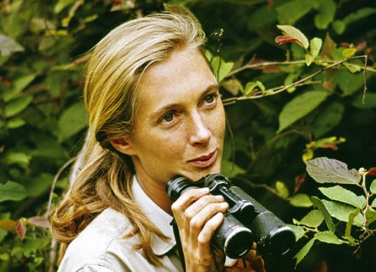
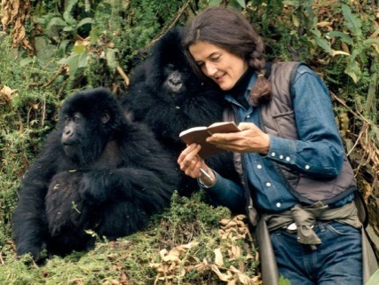
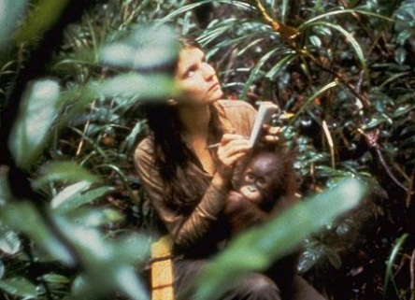
Long-term field studies of free-ranging apes
Notes:
Jak hlavní události v dějinách primatologie a antropologie ovlivnily naši volbu modelů…

Slide 12
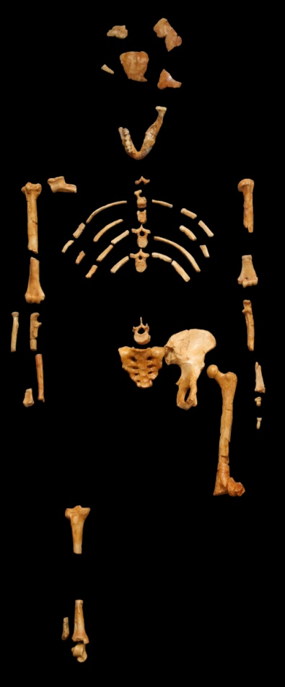
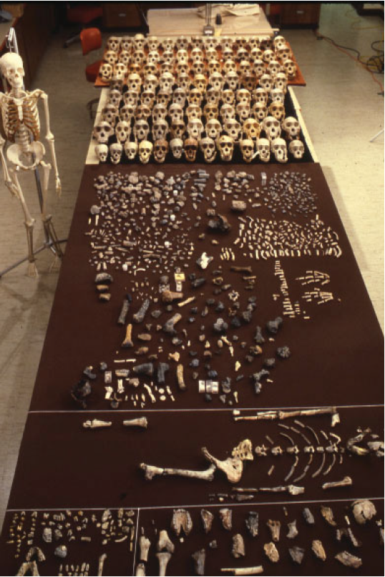
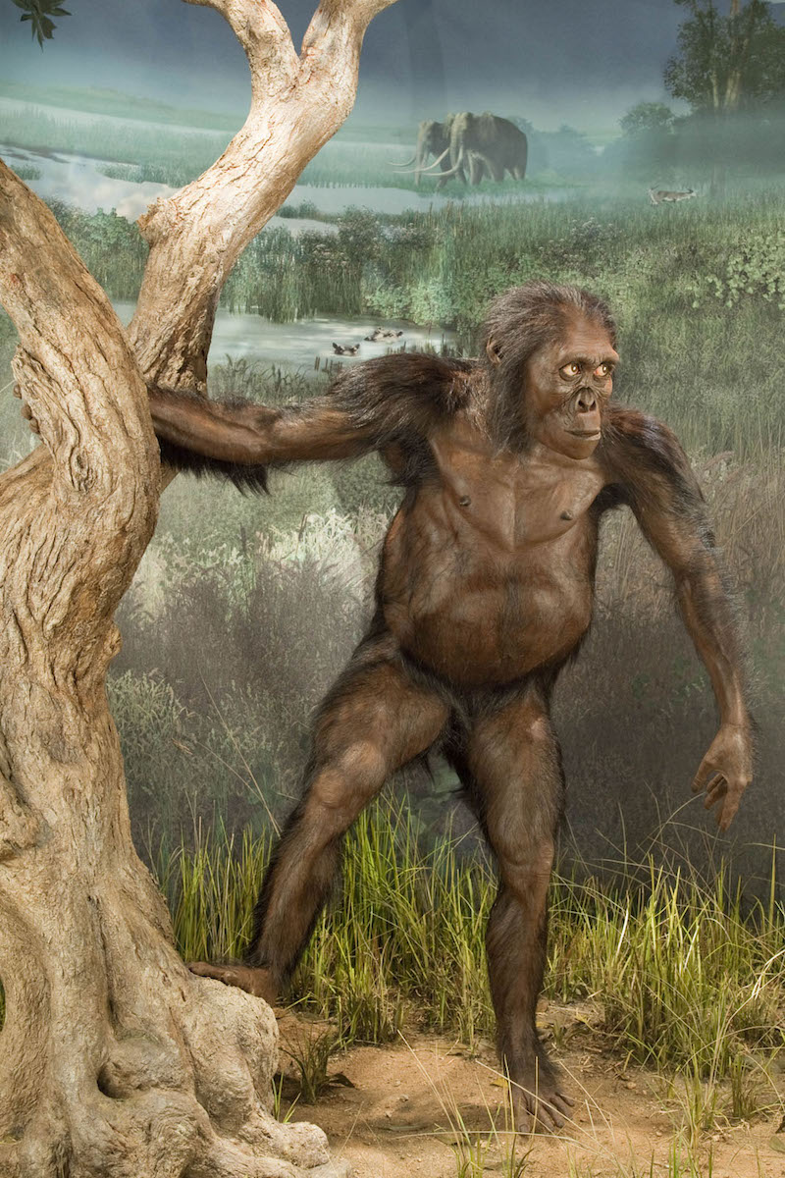
Discoveries of extinct hominin species
Notes:
Afar (Hadar, Etiopie); 1973. Stáří cca 3,7 milionů let, mozek šimpanzí (380–430 cm³), ale poměrně pokročilá forma bipedie ve 20. století jednoznačný předek lidského rodu, dnes ji sami objevitelé pokládají za předka robustních australopithéků.
Hadar hominin fossils assembled for comparative study at Cleveland Museum of Natural History, circa 1979. The A.L. 333 sample occupies the largest area at the center between ‘‘Lucy’’ and Hamann-Todd collection chimpanzee skulls; casts of the Laetoli hominins are at lower left.

Slide 13
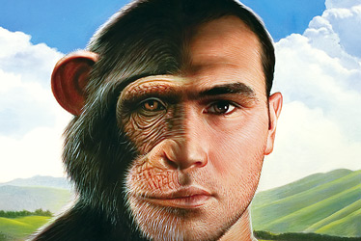

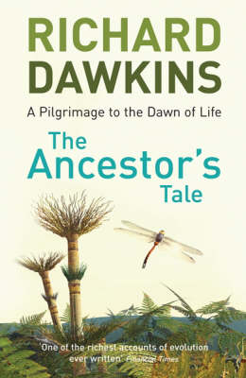
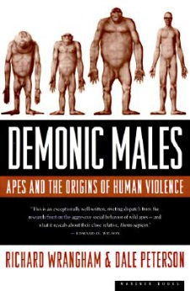
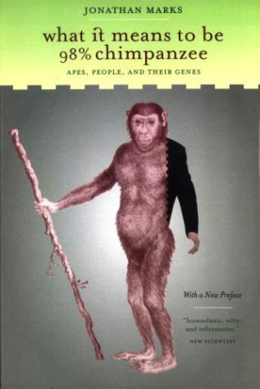
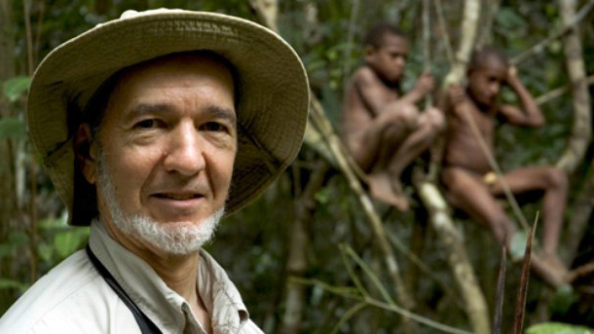
Chimpanzee-based referential models
"Certainly, it is hard to picture how fathers and mothers could cooperate harmoniously at rearing their children if human females resembled some primate females in having their genitalia turn bright red at the time of ovulation, becoming sexually receptive only at that time, flaunting their red badge of receptivity, and proceeding to have sex in public with any passing male. [...] Our life cycles are exceptional compared not just to living apes but also to other primates, suggesting that we were the ones who did more changing.” Jared Diamond, 1992

Slide 14
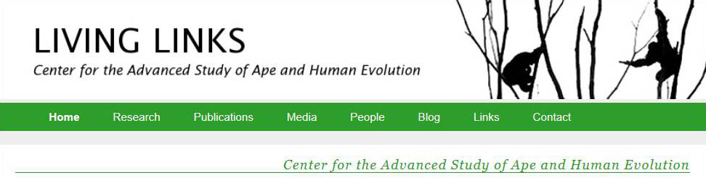
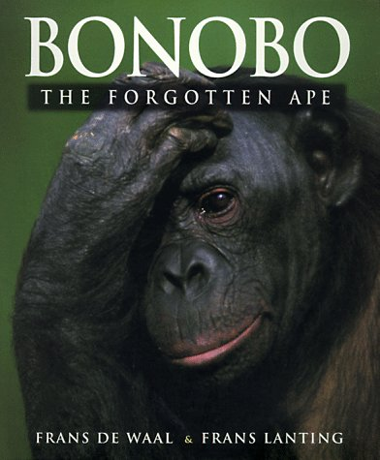
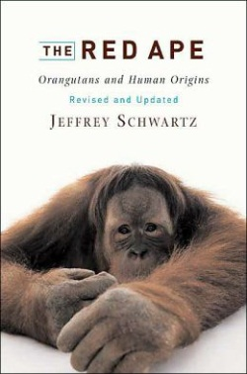
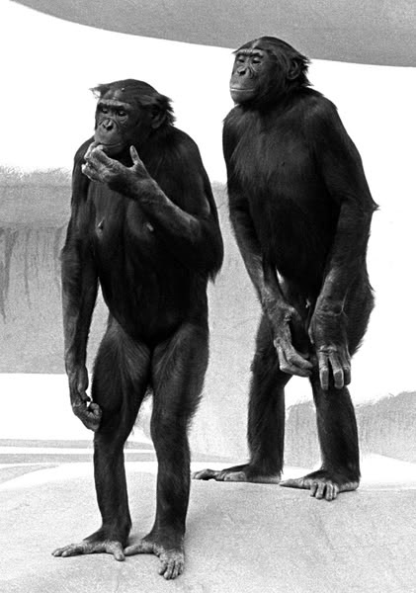
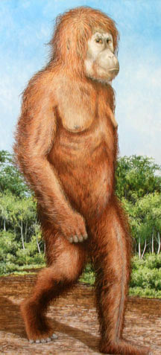
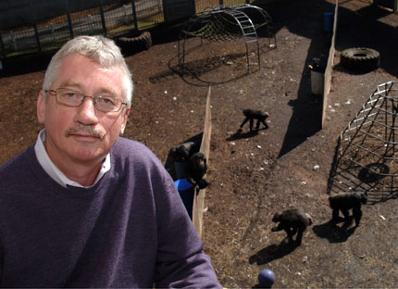
Alternative models
"In the same way that paleontologists prefer their fossil finds to belong to a human ancestor rather than to an extinct side-branch, experts on ape behavior like to claim that their subjects are the only or best model of the last common ancestor." Frans De Waal, 1998
Notes:
Tak jako antropologové (i ti evoluční) mají sklon nadhodnocovat jedinečnost (odvozenost) člověka (lidské biologie), mají primatologové častou tendenci nadhodnocovat význam objektu svého zájmu co by vhodného modelu pro rané lidské předky.
The pragmatic reason for favoring Pan troglodytes has always been the unprecedented wealth of data on wild chimpanzee behavior.
Adrienne Zihlman, Frans De Waal (proponenti bonoba)
David Geary (proponent Goril)
Jeffrey Schwartz, John Grehan (proponenti orangutanů)
Jsou rozpočty primatologických výzkumů založené na tom, že lidoopi v grantových žádostech vystupují jako stroje času?

Slide 15
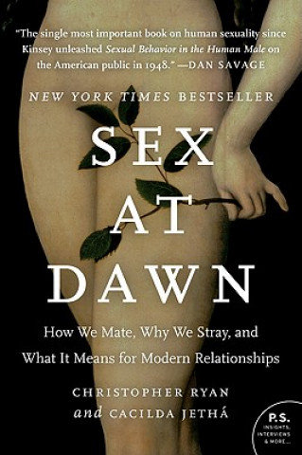
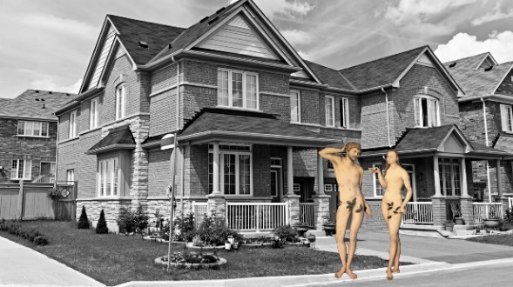
Alternative models
Sex at Dawn (Ryan & Jethá, 2010)
Presented as a response to "Flintstonization" of ancestral hunter-gatherer society
Argue that monogamy is unnatural (and that ancestral social system was promiscuous, bonobo-like)
Does Consensual Non-Monogamy Address The Recurrent adaptive Challenges Of Having Multiple Intimate Partners?
That depends…
Notes:
The controversy:
https://lithub.com/100-books-that-defined-the-decade/11/
The interview:
https://nextnature.net/story/2020/why-monogamy-is-unnatural
The book argued, basically, that monogamy is not the natural state of human sexuality. Authors Ryan and Jethá defied conventional wisdom around the development of human sexuality by writing that human beings did not evolve to be monogamous. They drew on research from anthropology, primatology, and other fields to argue that the monogamous nuclear family structure was created for economic reasons after the rise of agrarian life, but that system did nothing to change human beings’ naturally promiscuous instincts, and misunderstanding those instincts has led to misinformation and unhappiness in modern life, also a lot of divorce.
One of the decade defining books by LitHub (so in the comany of The Song of Ice and Fire and Fifty Shades…)
…
Is CNM better than NNM? Sure… Is non-monogamy natural (i.e., adaptation or adaptive?) and therefore is NM a challenge?

Slide 16


Alternative models
?

Slide 17

Why did concealed ovulation evolve? (i.e., why was the advertised ovulation lost?)
Can be an adaptation to:
Monogamy (concealed ovulation promotes permanent male-female associations and paternal care)
Non-monogamy (paternity confusion)
Bipedality (sexual swellings hampers bipedal walking)
Saving water (an adaptation to dry, savannah environments)
Notes:
Other theories: Incerased muscle and/or fatty tissue volume on the buttocs, increased importance of olfactoric communication…

Slide 18


Why did concealed ovulation evolve?
Advertised ovulation in chimpanzees and bonobos is uniquely derived
Convergent evolution of chimps and spider monkeys (Ateles)
Evolved in concert with penile morphology and ejaculate properties

Slide 19



LCA
H.
P.
G.
Notes:
Interspecific comparisons are also used frequently to elucidate the end-point and/or the process of evolutionary adaptation, that is, genetic changes in response to natural selection.
Specifically, interspecific correlations between some aspect(s) of the phenotype and some aspect(s) of the environment are taken to indicate that past and/or present natural selection acting on the character(s) of interest has played some role in causing its diversification and/or maintenance. Although most workers accept that character-environment correlations provide at least some evidence pertaining to adaptation, the reader should note that how best to study adaptation-and even how to define it-is a very controversial subject in evolutionary biology.
Claims about adaptation are commonly made from comparative studies involving only two species (or only two populations of a single species). Our main purpose here is to alert practitioners to several logical and statistical problems associated with using two-species comparisons for studying adaptation and to outline some alternative approaches. Multispecies comparisons are one such alternative. However, data from multiple species may not be independent or identically distributed in the statistical sense, which violates assumptions of ordinary statistical methods (Harvey and Pagel 1991).

Slide 20
Practical, part 1

Slide 21






Phylogenetic comparative methods
Trait evolution
Regression
What standard regression assumes
What phylogenetic comparative methods assume
Notes:
The extravagant plumage traits of male birds are a favourite example of sexual selection. However, to date the units that selection is acting upon, the genes themselves have been a ‘black box’. Here, we report evidence of change driven by sexual selection at a pigmentation gene locus in the galliform birds. Across species, we find a correlation between the rate of amino acid change (dN/dS) at this locus (MC1R) and the degree of sexual dichromatism, which we use as a measure of the strength of sexual selection. There is no evidence for a similar pattern in any of five other loci (four candidate and one control locus). This is consistent with previous work on colour polymorphisms and suggests that MC1R may be a key target for selection acting on plumage colour. The pattern of selection at MC1R seems to be consistent with the continuous or cyclical evolution of traits and preferences that is the outcome of several Fisherian and good-genes models of sexual selection. In contrast, we found no support for models of sexual selection that predict an increase in purifying selection as a result of purging of deleterious mutations or for models that predict an increased rate of mutation in association with stronger sexual selection.
Figure 1 Reconstruction of plumage dichromatism evolution on the phylogeny of the galliform species used in this study. dN/dS ratios at MC1R are estimated for each dichromatism category, excluding grey branches genera are listed as: common name (scientific name, number of species sampled). An image of a male from each genus is shown to the right.
But the tree is no some magic ingredient that you will add and everything is cushty..
Hypothesis of homology: primary homology – secondary homology…

Slide 22


What you need to figure out first…
Phylogeny = topology and branch lengths (proportional to time or amount of evolutionary change?)
What should the phylogeny be based on (molecular, morphological, linguistic data?)
Character coding (how is the diversity best described to allow for testing your hypotheses?)
Method of ancestral state reconstruction: optimality criterion or model-based?

Slide 23






Software

Slide 24
Materials
github.com/gabrielsaffa/ISHE_workshop_2023

Slide 25

Open Winclada…

Slide 26


Phylogenies
Where to get trees (if you don’t want to build them yourself)?
10ktrees.org
vertlife.org
Repositories of time-calibrated, Bayesian vertebrate trees
You can easily download a specified set of taxa and sample of trees

Slide 27

Open Mesquite…

Slide 28







Character coding
Binary or multistate?
Additive or nonadittive?
Discreet or continuos?
Weighted or unweighted?
Every character = hypothesis about homology
Optimization?
n = 7; x = 3; x^{n} = 729 (!)
Notes:
Character state optimization parsimony:
https://www.slideshare.net/graemelloyd/effects-of-ancestral-character-estimation-on-methods-for-estimating-rates-of-evolution-in-discrete-morphological-characters
Minimalizace počtu evolučních změn na kladogramu…
Různé typy optimizace (ACCTRAN, DELTRAN apod…)
Různé typy parsimonie (Farris, Camin-Sokal, Dollo)
Parsimonie je zastaralá, ale je intuitivní a komputačně nenáročná ☺
Nevýhody parsimonie:
Předpoklad, že evoluce běží parsimonně
Nebere v potaz různé délky větví
Potenciálně velký vliv vážení znaků
Diskrétní kódování znakových stavů, často binární, tj. vytváření falešných dichotomií
Neumožňuje zohlednění vnitrodruhové variability (a behaviorální flexibility)

Slide 29


Homology?
Male androgen-dependent sexual adornments

Slide 30



Results
1 = Gestation length; 2 = Interbirth interval;
3 = Mating strategy; 4 = Paternity certainty;
5 = Testes size; 6 = Intromission duration;
8 = Infanticide; 9 = Paternal care; 10 = Tool use
jedinečné
apomorfie
homoplázie

Slide 31

Results

Slide 32

Human behavioral diversity
Notes:
Including the diversity of social organization…

Slide 33







Human behavioral ecology
Measures human behaviors across environments and their effect on fitness (i.e., some proxy for fitness)
Does not consider the underlying processes, e.g., evolutionary history ("phenotypic gambit")
Uses present-day hunter-gatherers as referential models for human ancestors
(Proxies for fitness and proxies for ancestors are always problematic)
Notes:
Takže behaviorální ekologové zkoumají lidské chování, jako chování každého jiného zvířete.
Například jak tady na fakultě zkoumáme lovčíky na Vrbeňácích – jak hodnotné dělají samečci pro samičky dárečky a kolik budou pak mít v závislosti na tom v průběhu sezóny kopulací…
Frank Marlowe (Hadza)
Napoleon Chagnon (Yanomamo)
HBE = human evolutionary ecology, darwinian anthropology
EP = darwinian (experimental) psychology
Human behavioural ecologists aim to apply the principles of behavioural ecology to humans. Their main goal is to explain the diversity of human behaviours in terms of their biological function, that is whether and how they are adaptive in the context of the local environment. (This does not mean that behavioural ecologists maintain that all behaviours are adaptive: some might be maladaptive, and others might be neutral with respect to fitness.)
Behavioural ecologists study how human behaviour adapts to ecological and social conditions. While they (tend to) assume that behaviour has evolved to maximize inclusive fitness, they remain largely agnostic about the proximate mechanisms responsible for the behaviour, including how the trait is inherited as well as its cognitive and psychological underpinnings.
33

Slide 34








Evolutionary psychology
Searches for (ancient) adaptations in human psychology and cognition
Operates with the concept of the "Environment of evolutionary adaptatedness"
Human behavior (and cognition) are adaptated to past (ancestral) environment
But the concept is generally true but vague
Notes:
EP works to kind moderate the underlying assumption of HBE: We shouldn’t expect human behavior to be adaptive.
EP is not interested in behavioral diversity!
Human behavioural ecology, focuses on biological fitness and whether a given behaviour is adaptative in its ecological context. Evolutionary psychology, focuses on universal cognitive adaptations supposed to have a genetic basis. Its proponents tend not to investigate why culture (behavior) varies between individuals or populations, focusing instead on species-specific cognitive mechanisms shared by all members of our species.
Evoluční psychologové nejezdí do terénu. Když už do terénu jdou, tak tím terénem je kampus vysoké školy. Pochytají studenty a ty zpokusujou. A předpokládají, že VŠ studenti jsou normální lidi, což nejsou….

Slide 35

Environment of evolutionar adaptedness
Notes:
But the EEA concept is generally true but vague (we don't know anything specific about it)
Humans are, in fact, adapted to a range of differrent environments!
HBE se ptá: Je studované chování adaptivní? A EP se ptá: Je studované chování adaptace? A to je rozdíl!

Slide 36


Cultural evolution (incl. phylogenetic) approaches
Cultural evolution, cultural phylogenetics, gene-culture-co-evolution (or dual inheritance theory), also memetics
Cultural evolution is interested in evolution of behavioral diversity - how did (adaptive and maladaptive) traits evolve
Although human behavioral ecology and cultural evolution seem to be different fields, they are two kinds of explanation that are hard to tell apart in the real world (Mace, 2014)
Kirby et al. (2016)
Notes:
The same term – cultural evolution – is used to identify both a phenomenon and a theory to explain it is unhelpful. It not just because there are many unclear whether one is referring to an explanandum—what we are trying to explain—or an explanans—the set of statements we use to explain it.
The unhelpful use of the term “cultural evolution” to indicate both a phenomenon – culture changing through time – and a theory to explain it – the central role played by transmission biases in shaping culture and an associated focus on cultural inheritance. Ambiguity surrounding this term is widespread both in the literature and in informal discussion.
Cultural traits and biological traits (insofar as they can be classified as such) do coevolve. Culturally constructed environments exert selection pressures on behavior, including the mechanisms that control the behavior, which could lead to genetic change.
Behavioral ecology is the only science that seeks to identify adaptations in human behavior, while EP and CE are invoked whenever there is a need to explain maladaptive behavior – using mismatch or evolutionary lag (invoking the EEA concept), historical constraint or a mode of cultural transmision (e.g., conformism or prestige-bias copying) that prevents us to achieve optimality of behavior…
Kultura je to, čím, vysvětlíme ten mismatch nebo to evoluční zdržení, o kterém pořád mluví evoluční psychologie:
EP (+ CE): We are „neanderthals in the tuxedo“ that fall prey to unconcious transmission biases.
We could be fit ad health, but we stuff ouresleves with junk food and soft drinks because we have this evolved preference for high-energy food and sugar, we break up monogamous unions because mens have this evolved preference for sexual novelty and we dont have any children because we have the tendency for prestige-biased copying (and conformity) so we emulate high-status individuals (e.g., celebrities) and then we behave just like everyone else, although it is good for us (and our genes) to have more children and to have them earlyer. And we believe various nonsenses that make us behave in harmful ways.

Slide 37

Four questions, three approaches
CAUSATION
How does the trait work?
How is it elicited?
DEVELOPMENT
How does the trait emerge?
SURVIVAL VALUE
Why is the trait adaptive
Why does the trait persist?
EVOLUTIONARY HISTORY
How did the trait evolve?
Why did the trait evolve?
Micheletti et al. (2022a)
Culture is a way through which we adapt to different environments (and the environment we adapt to is to a large degree "cultural"); "Culture" is a behavior that is culturally transmitted (and almost all behaviors are)
Notes:
Another point of confusion…
Evolutionary psychology uses culture as a way to explain why we aren’t (well) adapted to our (current) environment…
Once this confusion is resolved, it becomes clear that human behavioural ecologists have studied cultural evolution from the very beginning. The aim of behavioural ecology is to explain human behaviours (whether and how behaviours serve an adaptive function), and the vast majority of them are at least to some extent cultural (influenced by social learning, imitation, etc.). In addition, culture forms part of the ecology that determines the costs and benefits associated with adopting a behavior. Thus, human behavioral ecologists have studied cultural evolution all along, they have not focused on social learning.
Why do I/you have sex?
Because I am horny (mechanistic); Also, I could talk about complementary morphology of male and female genitals…
Because sex is an innate behaviour that you dont have to learn, but there is some cultural variation… (developmental);
because all apes do it like that, well, not all apes, actually (phylogenetic);
Because I am programed by my genes to get my genes into the next generation (evolutionary function);
It follows that, in most cases, human behavioural ecologists study the cultural evolution of human behaviors. Specifically, they do so in two ways.
1) The behaviour being studied is an aspect of culture, a culturally transmitted trait whose adoption is shaped by an individual’s ecology.
2) At the same time, culture forms part of the environment that determines the costs and benefits experienced by individuals.
Human behavioral ecology makes predictions about behavior based on biological fitness goals, regardless of whether that behavior is transmitted genetically or culturally or a bit of both.

Slide 38


Galton's problem
E. B. Tylor (1888): Since acephalous and tribal societies are often matrilinear and more complex societies are patrilinear, matrilinear social system is the ancestral one…
F. Galton: We cannot infer anything about the evolutionary sequence, unless common descent is taken into account
"Phylogenetic autocorrelation"
Notes:
Dva problémy:
1) Jaký může být přínos HBE behaviorální ekologii jako celku, když jen málokteré metody BE lze aplikovat na humany?
Barrett, L., & Stulp, G. (2013). The pleasures and pitfalls of studying humans from a behavioral ecological perspective. Behavioral Ecology, 24(5), 1045-1046
https://academic.oup.com/beheco/article/24/5/1045/253982?login=true
2) Když jsme behaviorální ekologové a chceme studovat adaptace (na základě mezi-kulturního srovnání), potřebujeme fylogenezi, i když nás historické procesy vůbec nezajímají!
Human behavioural ecologists rely mainly on observational studies within populations and cross-cultural comparisons (instead of cross species comparisons, Pagel and Mace 2004). The comparative approach focuses on systematic differences between cultures that are relatively homogenous within each group, such as languages. When performing cross cultural comparisons, it is necessary to account for “Galton’s problem”, the fact that similarities between cultures may stem from shared ancestry rather than having evolved independently. Phylogenetic cultural comparative studies allow us to control for this phylogenetic association, thus solving Galton’s problem (Mace and Pagel 1994). And, possibly more importantly, some phylogenetic comparative methods provide a formal model of the direction of cultural evolutionary processes that can be tested.
Behavioural ecological studies try to identify the adaptive drivers behind cultural traits by employing elements of the rich behavioural ecology toolkit… This toolkit includes cross-species comparisons using phylogenetic methods, which model how traits have co-evolved over time and identifying the ecological drivers of change from ancestral states.
As experimental manipulations relating to fitness are not possible in humans due to obvious ethical reasons, in order to test predictions, human behavioural ecologists rely mainly on
observational studies within populations and cross-cultural comparisons (instead of cross-species comparisons). The comparative approach focuses on systematic differences between cultures that are relatively homogenous within each group, such as languages and kinship systems.
E. B. Tylor: Společnosti s jednodušším sociálním uspořádáním jsou zpravidla matriarchální → patriarchální společnosti ze vyvinuly z matriarchálních
F. Galton: Z korelace mezi složitostí společenského uspořádání a rodinným uspořádáním nelze vyvozovat nic o evoluční sekvenci, pokud nezohledníme příbuzenské vztahy
n 1888, Galton was present when Sir Edward Tylor presented a paper at the Royal Anthropological Institute. Tylor had compiled information on institutions of marriage and descent for 350 cultures and examined the associations between these institutions and measures of societal complexity. Tylor interpreted his results as indications of a general evolutionary sequence, in which institutions change focus from the maternal line to the paternal line as societies become increasingly complex. Galton disagreed, pointing out that similarity between cultures could be due to borrowing, could be due to common descent, or could be due to evolutionary development; he maintained that without controlling for borrowing and common descent one cannot make valid inferences regarding evolutionary development. Galton's critique has become the eponymous Galton's Problem.

Slide 39


Galton's problem
Two problems, actually:
Wihout phylogeny, we can not infer when the trait evolved (it hampers our ability to devise hypotheses about adaptation)
Without phylogeny, we cannot infer whether it IS an adaptation (it hampers our ability to detect instances of convergent evolution)
Notes:
If we want to study adaptations (of secies, populations), we need hypothesis about:
Phylogeny
Homology

Slide 40



Galton's problem
Efforts to mitigate Galton’s problem using samples of "independent" societies, e.g., the Standard Cross-Cultural Sample, SCCS by G. P. Murdock
These societies are not actually independent…
But how to build a tree of human populations?
Notes:
Tento problém, společný antropologii i evoluční biologii, si antropologové uvědomili jako první a v průběhu dvacátého století se s ním snažili vypořádat různými způsoby, zpravidla vytvářením datasetů pro komparativní analýzy, sestávajících z „nepříbuzných“ společností (např. takzvaný Standardní mezi-kulturní vzorek). Takové metody mohou Galtonův problém umenšit, ale nikoli eliminovat. V 80. letech vyvinuli evoluční biologové statistické metody umožňující měřit znakové korelace se zohledněním fylogenetických vztahů a také rekonstruovat evoluční historii. Od 90. let začali tyto metody využívat i sami antropologové. Zakládají se na kombinaci etnografického záznamu a fylogenetického stromu lidských etnik, založeného na analýze genetických nebo lingvistických dat, a umožňují nejen testovat evoluční sekvence navržené antropology, ale také rekonstruovat aspekty života dávných společností, které nezanechávají stopy v antropologickém záznamu.

Slide 41




Language trees
Gray et al. (2009)
Currie & Mace (2011)

Slide 42

Tree of trees
Matrix representation with parsimony supertree (consensus tree)

Slide 43




Diversity of human family
Notes:
The ideal and Ghana, Tibet, and the UK (royal family).

Slide 44




Why polygyny?
Polygyny predominates across societies (>80%)
But most individuals marry monogamously (even in societies where polygyny is the norm)
Polygyny threshold model: Women should marry polygynously when variance in male quality is high
Becoming a second wife of an already marriaed man offers greater (expected) fitness benefits than becoming a first wife of an unmarried man
Dow & Eff (2013)
Marlowe (2000)
Barrett et al. (2002)
Notes:
PT model: Woman should mate/marry polygynously when variance in male quality is high (originally variance in the quality of teritory, but also good genes or some indicator thereof, wealth or resources)

Slide 45

Why polygyny?
Polygyny threshold: good genes, good health
Polygyny threshold: wealth (resource-defense polygyny)
Male coercion, male-male competition (harem-defense polygyny)
Female-biased sex ratio (as a consequence of high male mortality)
High male parental investment and wealth is impartible (e.g., land)
Cultural group selection of monogamy (socio-political complexity)
Notes:
Sociální nerovnost/stratifikace (majetkové rozdíly), zvýšená kompetice (válečnictví), rozdíly v kvalitě partnerů (prevalence patogenů), mužský podíl na zajištění domácnosti…
This allows us to control for non-independence, and further, to quantify the extent to which behavioural variation is explained by current socio-ecological conditions as well as population history in a globally representative sample.
We show that the phylogeny explains more than twice as much variance as all the predictors, and that ignoring phylogeny leads to both false positives and false negatives.
Pathogen stress and assault frequency emerged as the strongest predictors of polygyny, consistent with expectations based on sexual selection theory.
Tahle práce jednak představuje fylogenezi SCCS populací, jednak na příkladu rodinného uspořádání ukazuje, že bez fylogeneze se v behaviorální ekologii skutečně neobejdeme.
Obor/odvětví bádání spojující fylogenetiku s kulturní antropologií je volné hřiště…
Nejde o nic menšího, než o posunutí studia kulturní makroevoluce na globální úroveň a o zakomponování fylogenetického/historického aspektu do výzkumu behaviorální ekologie člověka…
Jsme teprve na počátku dlouhé cesty…

Slide 46



Evolution of marriage
Phylogeny explains about twice as much variance in polygyny as all 11 predictors combined!
Notes:
This is the phylogeny and you can see that these societies definitelly aren’t „independent“ in that they are equally (un)related. Polygyny has a high phyloenetic signal.
Global sample and global phylogeny provide more power to detect independent co-evolutionary events, here convergent evolution of marriage patterns in response to similar socio-ecological conditions, which is what phylogenetic comparative methods were designed to do…
By the way, this tree was since used to study other human behaviors (religious beliefs, food sharing norms, alloparental care, or dwelling size in relation to soc. organization – residence rules) and not all human behaviors display such phylogenetic clustering… but marriage patterns are among those that do.
The two strongest predictors of polygyny are pathogen stress and assault frequency (polygyny threshold model and harem-defense polygyny?)

Slide 47

"Phylogenetic control"
Not controlling for phylogeny causes false positives and negatives
Reduced support: e.g., parental investment
Increased support: e.g., internal warfare
Most support: pathogen stress and assault frequency (support for polygyny threshold and harem-defense polygyny?)
What about wealth and resources???
Notes:
Such high phylogenetic signal…
Number of false positives (as well as negatives) thanks to phylogenetic control.
Some predictors have reduced support in the phylogenetic model (e.g. population density, role of father in infancy, sex ratio), indicating an elevated risk of false positives when ignoring nonindependence.
However, others (e.g. wealth inequality, warfare) receive more support in the phylogenetic model, indicating an elevated risk of false negatives.
The false positive rate found here (4/26 tests, 15%) quite low, perhaps partly because the SCCS populations are indeed quite "independent", but perhaps more so because our analyses included multiple predictors rather than conducting bivariate tests, thus reducing the number of significant associations to begin with.
Our analysis provides the strongest support for a polygyny threshold based on male genetic quality and for harem-defense polygyny
The two strongest predictors of polygyny, pathogen stress and assault frequency - polygyny is prevalent where fewer men are able to develop healthy phenotypes (pathogens and violence exacerbate variation in male genetic quality)
All else equal, only 1.63% of married men are expected to be polygynous in a population experiencing minimal pathogen stress, but 6.36% of married men in a population experiencing maximum pathogen stress; a four-fold increase (Fig. 5a). Similarly, at minimum levels of assault frequency 3.56% of married men are expected to be polygynous, but 8.05% at maximum level of assault frequency; a twofold increase (Fig. 5b).
Also - violence puts premium on male protection of women and their offspring (another aspect of male investment)
Lastly, assault frequency could also indirectly influence polygyny by altering the sex ratio.
That said, we found no support for marriage patterns to be influenced by the sex ratio. This could be because sex ratio effects operate through mechanisms better captured by other variables in the model (violence?)
But marriage patterns "explained" by phylogeny rather than ecology?
No - populations inherit ecological niches from their ancestors
As mentioned above, the influence of culture and ecology can be difficult to disentangle as populations select similar ecological niches as their ancestors (e.g. Bantu speakers in East Africa choosing wetter areas; Borgerhoff Mulder et al., 2001), which influences their behavior (e.g. 50% of the variation in female contribution to subsistence explained by being Bantu; Burton & White, 1984)
Polygyny (esp. In Africa) is thought to be a harful cultural practice, because…

Slide 48







Evolution of normative monogamy

Slide 49







Why monogamy?

Slide 50





Why monogamy?
Societies with greatest wealth unequalities (i.e, greatest differences among males) impose social monogamy
Monogamy is the law and law is made by the elites (i.e., political and religious leaders)
Notes:
While the observed levels of polygyny among foraging, horticultural, and pastoral societies are consistent with the polygyny threshold model, based on the variance of male wealth and status, it fails to explain historical decline of polygyny among agricultural societies. The the unequal distribution of resources and other fitness-relevant traits should lead to (resource defense) polygyny.
Marriage norms are imposed from the top, rather than from the bottom up. In all modern societies, monogamy is the law and law is made by the elites (i.e., political and religious leaders). Why would these top-ranking men, who would be the most likely to acquire harems, devise, or allow, a marriage system that removes their prerogative to even a single co-wife or mistress? Why would they impose marriage norms that reduce the variance in male reproductive success – seemingly against their own self-interest?

Slide 51


Why monogamy?
The consequence (and also a cause) of polygyny are elevated crime and violence rates
Henrich et al. (2012): Complex, stratified societies have to minimize intragroup conflict
Outlawing polygyny gives all men equal reproductive opportunities, decreases male competition, and promotes intragroup cooperation
Monogamous societies defeat, assimilate, or outlive polygynous societies (group selection)
Notes:
Some theories invoke cultural group selection, arguing that monogamy is a reproductive-levelling mechanism that promotes success in inter-group competition. In highly unequal societies, high levels of (resource-defense) polygyny produce a large pools of unmarried men who are responsible for elevated rates of crime and violence. These can drive levels of (harem-defense) polygyny further up, since elevated assault frequency puts a premium on male protection of women and their offspring.
However, complex societies that rely on) male specialization (e.g., trade and commerce), or recruit large numbers of young men to wage wars, have to minimize this intragroup conflict. Outlawing polygyny gives all men equal reproductive opportunities, decreases male competition and promotes cooperation. In effect, these societies benefit from imposing monogamy as they tend to out-compete polygynous societies either through military conquest or acculturation.

Slide 52


Why monogamy?
Adaptation to the increasing importance of rival wealth (material wealth, but also paternal care)
Or - specifically - increasing scarcity of land following the transition to intensive agriculture
Limiting family size (and the number of heirs) to consolidate wealth over generations
Transition to monogamous inheritance should be accompanied by cultural norms promoting paternity certainty
?
Notes:
Other theories attribute the decline in polygyny to increasing importance of rival wealth, that includes material wealth, but also direct paternal care. Ross et al. (2018) showed that the level of polygyny is not solely dependent on relative material wealth inequality but rather on the way how wealth is distributed within the society. If the wealth is held constant among rich males, societies with more moderately rich men, that is pastoral and horticultural ones, will have higher levels of polygyny than societies with few extraordinarily rich men, as is the case for historical agricultural ones. As the rival wealth cannot be transmitted to all children irrespective of their number without diminishing in value, the fitness maximizing number of wives for a man decreases where in societies where importance of rival wealth increases. Consequently, only few men will be able to boost their fitness by obtaining additional wives and even those will not do so in full proportion to their wealth due to diminishing fitness returns from polygynous marriages.
Fortunato and Archetti (2010) view monogamy as an adaptation to scarcity of one particular type of rival wealth - arable land, that is a consequence of transition to intensive agriculture. According to their theory, increased agricultural productivity afforded by techniques such as plow or irrigation, triggered rapid population growth that led to land shortage.
This motivated land-holding men to limit their family sizes and the number of heirs in order to avoid depletion in the value of estates through partitioning among multiple heirs over generations. According to this theory, transition to monogamy is a transition to monogamous inheritance and should be accompanied by cultural norms promoting paternity certainty, such as virginity upon marriage and sexual fidelity. The underlying assumption is that increased paternity certainty should offset lower fitness returns from having only a single wife, as wives in monogamous unions their husbands higher sexual fidelity in exchange for exclusive male investment in their offspring. This should be feasible in societies where the fitness returns on male investment into the existing offspring, whereas those on obtaining additional wives are low.

Slide 53

Competing theories…
Not mutually exclusive
But some of them are in conflict with historical and ethnographic evidence
Some putative causes of monogamy are too young
Too many predictors?
Notes:
These theories are not mutually exclusive, since as they all view monogamy as an adaptation to sexual conflict that mitigate competition among unrelated males and/or family members (either offspring or co-wives) by limiting the number of heirs. However, some of them are n conflict with historical and ethnographic evidence.
Apparently, the only way to mitigate conflict among relatives is to have as few of them as possible…

Slide 54
Practical, part 2

Slide 55
Problems and limitations
All models are wrong but some are useful
Tree uncertainty (topology or branch lengths)
Trait uncertainty (unknown or coding limitations)
Model uncertainty (optimality criteria or models such as BM do not accurately represent how evolution works)…
Kirby et al. (2016)
Notes:
Tree uncertainty. There is uncertainty from the building of the phylogeny. Tree-building methods are not perfect and often are used with data constraints, especially limited sampling of both genomes and species. As such, there is always uncertainty about phylogeny. Species can be misplaced in a phylogenetic tree, ancestral nodes can be wrongly inferred, or more subtly, but more commonly, branch lengths are incorrect. If we are interested in species diversification and what traits promote or inhibit such diversification, it is not diffi cult to see how these mistakes in phylogenetic trees can influence our inference.
Trait uncertainty. For most PCMs, we use trait values representative for particular species. However, traits are measured with error. In addition, what constitutes ‘representative’ is a difficult issue. Often, a value from a single population is used and, not uncommonly, some trait values come from a single observation. Another relevant point is that trait variation within species can be very large. Think of our own species — what is a representative value for human height?
Model uncertainty. When we investigate trait evolution, we assume a certain model of evolution — most often, the Brownian motion model. However, a trait can evolve quite differently from such a simple model and there may be heterogeneity in the tempo and mode among the branches of the tree. Although approaches are now available to test among competing models and to represent process heterogeneity in a limited way, there is no guarantee that any of the current generation of models are adequate in capturing the true complexity of trait evolution through space and time.

